Slide 1
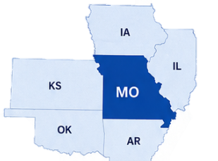


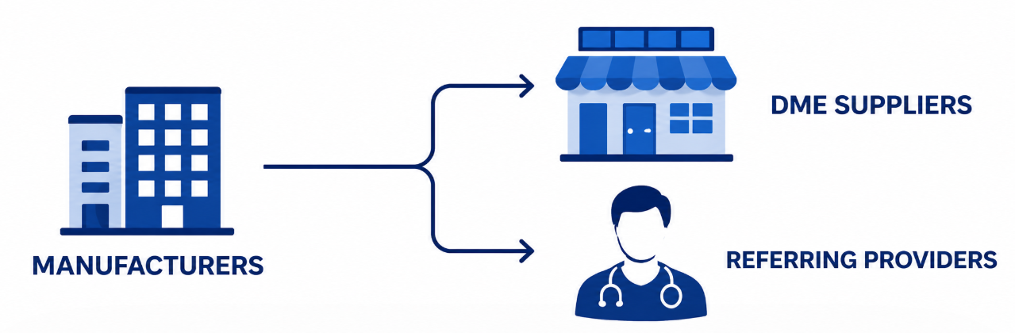
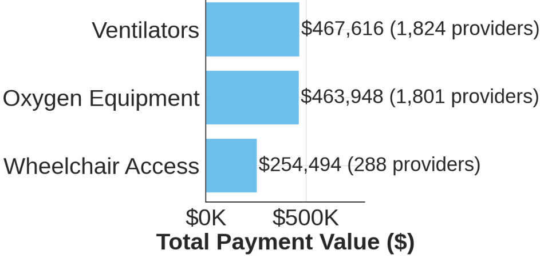

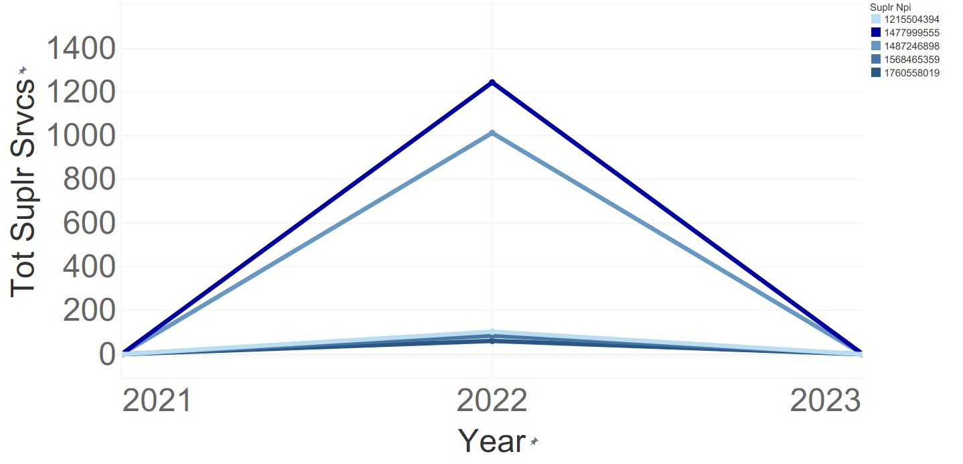
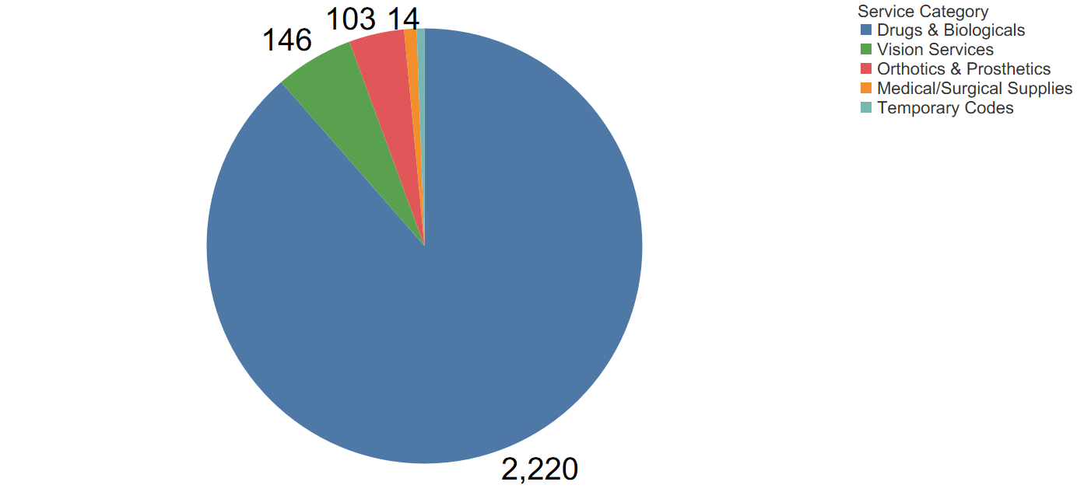
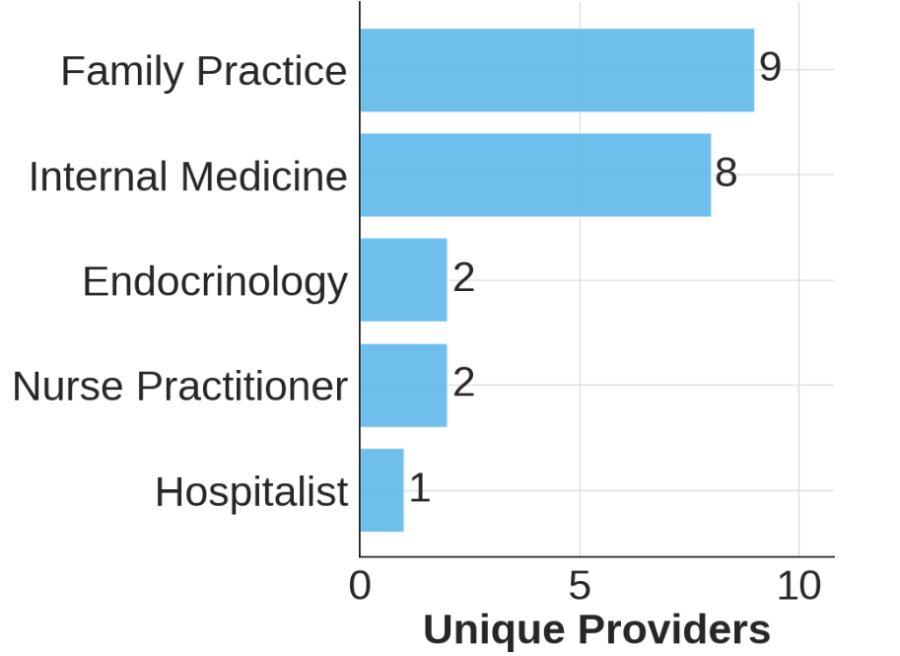


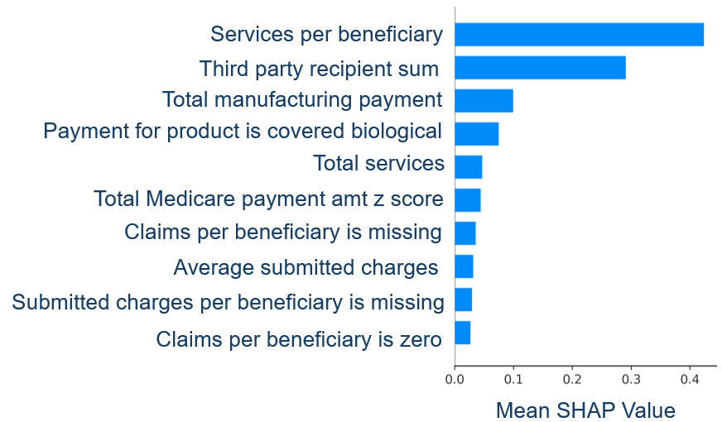

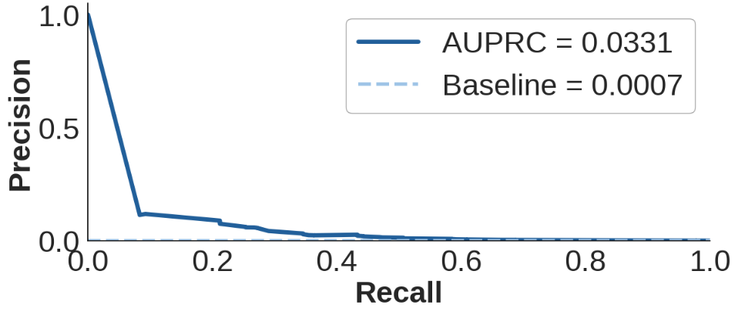
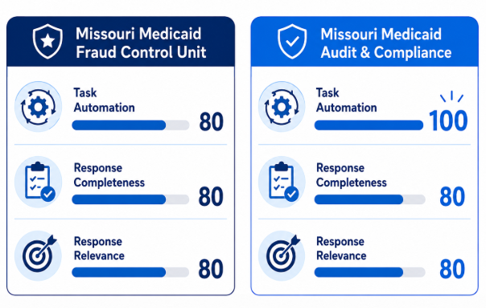

SABRINA WOO, CAMERON KASS, NARSIM KAMATH, LOVE AYINDE
Detecting Fraud Signals
in Centers for Medicare and Medicaid (CMS) Data
Fraud is an extremely rare event, but there may be signals to uncover. This project focuses on Missouri and bordering states, showing how public CMS data, machine learning, and AI assistants can help fraud investigators and analysts identify fraud signals in durable medical equipment (DME) data.
FOCUS REGION
Missouri and bordering states
A New Dimension to DME Fraud Review
Our project brings together data on key entities across the DME supply chain, including suppliers and providers who may receive incentive payments from manufacturers.
Top 3 DME Product Incentive Payments to Providers
Open Sunshine Payments are an untapped data source for fraud review.
Advances in Artificial Intelligence (AI) allow for better categorization of free text product data.
Fraud investigators can now monitor overall trends of incentive payments in high-risk DME products.
Identifying Supplier Billing Spikes
Billed Service Categories
A sudden spike in billing, especially when supplier activity shifts from none to high volume and then back to none, is a common fraud scheme and suggests unusual behavior.
Drugs and biologics are the most common amongst spikers.
Connecting Referring Provider Behavior to Fraud Outcomes
Top Specialties with Healthcare Exclusions
0.066%
of billing records from referring providers have current healthcare exclusions or fraudulent convictions.
We compared providers across specialties and provider types
Diabetes supplies and Contraceptives are the top billed service code by excluded or convicted providers.
We used stats to compare MO and bordering state referring providers across the entire nation
Detecting Fraud Signals Using Machine Learning
Top Fraud Signals
Best Model
The model is 50 times more likely to flag a record that is fraud compared to baseline.
Random Undersampling,
XGBoost,
No Payment Anomaly Detection Priors
Using Agentic AI to Improve Investigation Efficiency
AI Usability Scoring
AI Assistant Output
Are there any business filings in MO for X Hospital?
Our AI assistant uses a Model Context Protocol server to search authoritative sources and support transparency.
Yes, there are business filings available for 2026 [sos.mo.gov/XHospital]
MASTERS IN SCIENCE DATA SCIENCE AND ANALYTICS PROGRAM

